Slide 1

IMPLEMENTING AND CONFIGURING AZURE STORAGE AND BLOB SERVICES
By:
S.Sai Kiruthika
Information Technology-4th year
121015085

Slide 2
Internship Details
Company Name - Tech Mahindra
Internship Period - 3 Months
Internship Topic - Azure Cloud Fundamentals
Guided by - Manoj Kumar Raghupathi,
Senior Software Engineer,
Tech Mahindra.

Slide 3
Agenda
Problem Statement
Introduction
Methodology 1
Methodology 2
Result
Conclusion
Reference

Slide 4
Problem Statement
Ford hosts large amounts of unstructured and semi-structured data in its on-premises storage.
Its maintenance becomes increasingly complex and costly. Some of the data is preserved for extensive amount of time to address data retention requirements.
The Ford Enterprise Architecture team is looking for inexpensive alternatives that would support tiered storage, while, at the same time allow for secure access that minimizes the possibility of data exfiltration.

Slide 5
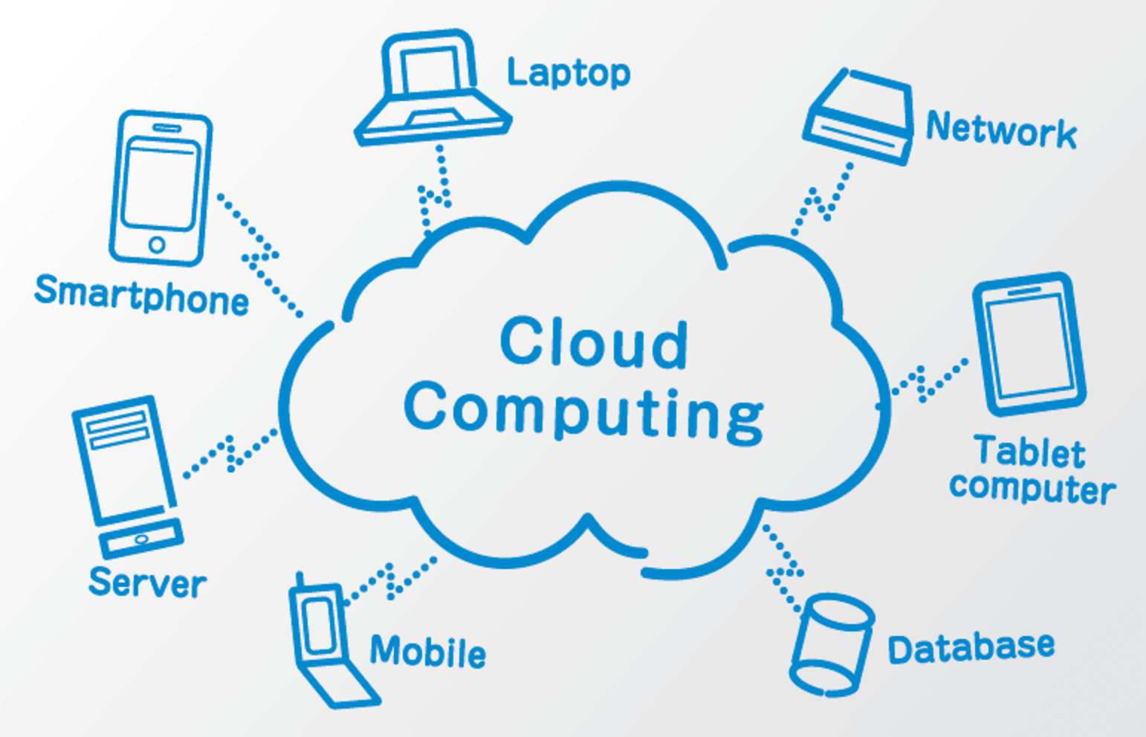
Introduction
Cloud computing is the delivery of computing services over the internet by using a pay-as-you-go pricing model. You typically pay only for the cloud services you use, which helps you:
Lower your operating costs.
Run your infrastructure more efficiently.
Scale as your business needs change.

Slide 6
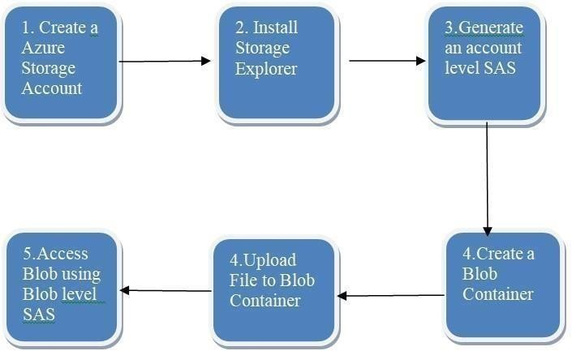
Methodology
IMPLEMENTING AND CONFIGURING AZURE STORAGE AND BLOB SERVICES

Slide 7
Methodology
1.Create an Azure Storage Account:
The business need is that their storage needs to be stored in Cloud other than on-premises. So, the first set is to create an azure storage account in azure portal. We must open an option called as Create a resource and in resource group we must create azure storage account.
2.Install Storage Explorer:
We have downloaded a storage explorer for connecting it with the azure cloud to access the resources. It must be downloaded from internet and we can connect the files or other types of storage with SAS key.

Slide 8
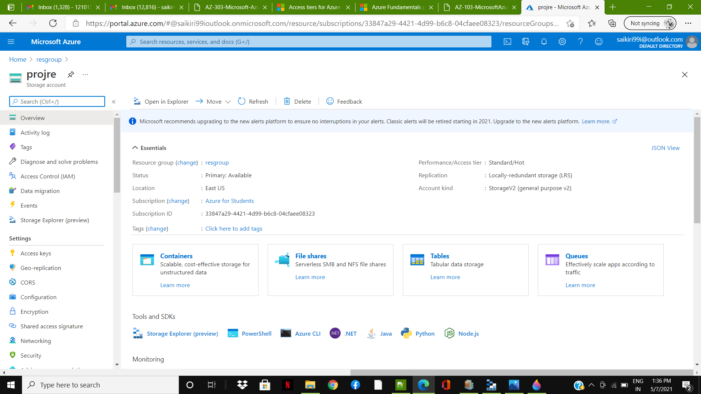
Methodology

Slide 9
Methodology
3.Create a Blob Container:
In this storage account we must create a blog container which is used to show large amount of data. After creating blog container, we must create a Role Assignment for the specific user who is using the project. We can assign up to 2000 role assignment in a storage account. After creating a specific role assignment for the owner as well as people in the project. We can then generate the shared access signature (SAS).

Slide 10
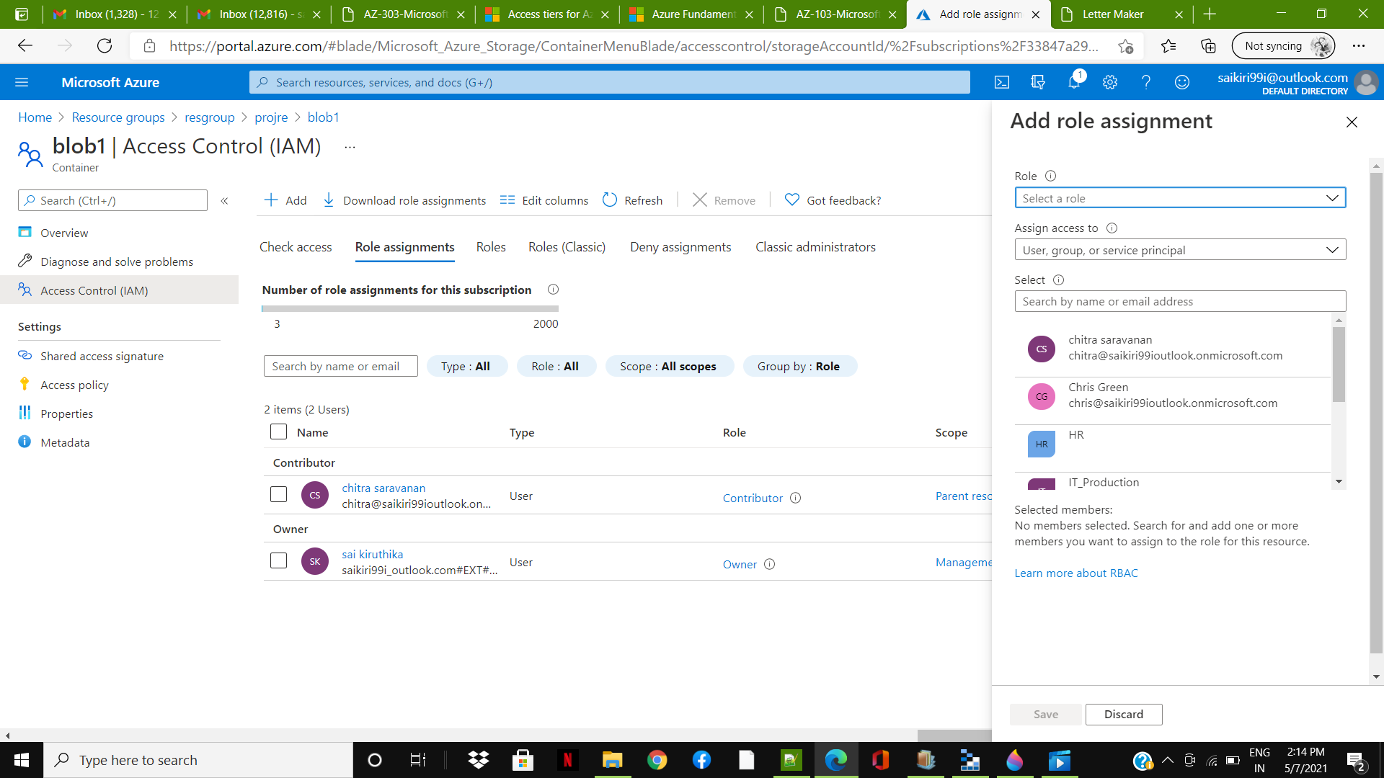
Methodology

Slide 11
Methodology
4.Generate an account level SAS:
In azure portal we need to deploy both a virtual machine and a storage account using the specific configuration which is needed by the business. In this project I have created a storage account under the resource group and in the storage account we have to specify the configurations like location in which we have to select the nearby cloud data center and Replication is selected as GEO- REDUDANT STORAGE (GRS) and performance selected as standard.we have enabled to allow storage key access and blob public access and after the validation is passed for the specific configuration the storage account is created. After creating the storage account, we need to generate an account level SAS which is presented in the left side of the storage account and we need to open that SAS and we need to generate it.

Slide 12
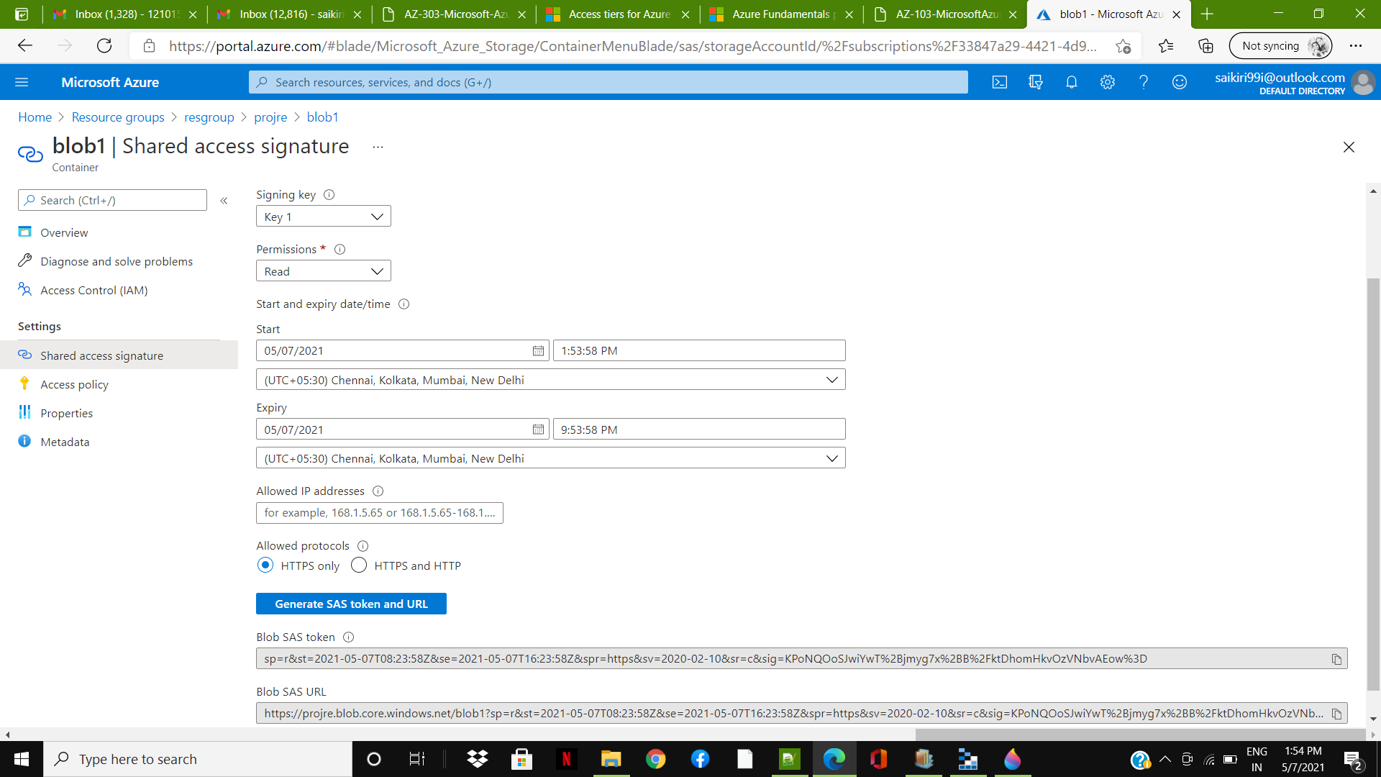
Methodology

Slide 13
Methodology
5.Upload file in a Blob Container:
We need to upload a large amount of data or video file to be accessed by the owner as well as the people who are working in this project. After uploading the specific file, we can generate a SAS by giving the start date and the location and the expiry date. We can also allow a specific IP address for the people to be viewed and it will be differing for each project according to the business needs. After that we can allow the protocols which is needed for this project. After clicking the generate SAS key the Azure cloud will give the specific SAS key which is needed to be accessed by the people in this project for the future use.

Slide 14
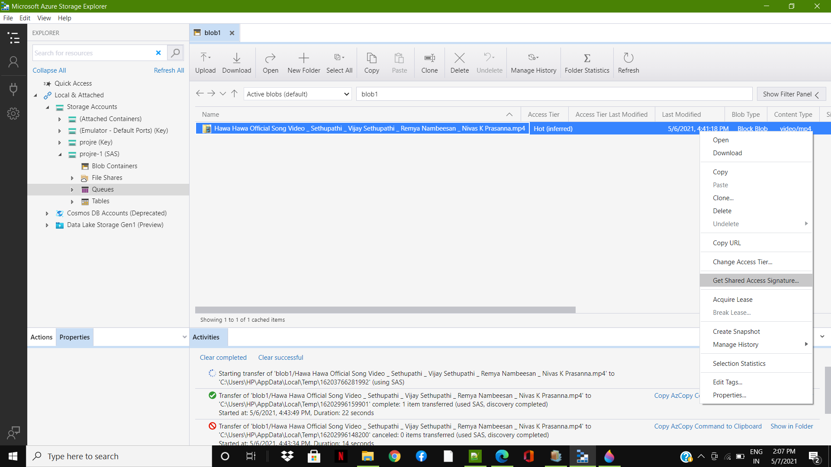
Methodology

Slide 15
Methodology
6.Access Blob using storage container:
After generating a specific SAS, we need to connect it with an external storage explorer. We need to connect a storage explorer with a Microsoft Azure cloud. After connecting, we need to connect a Blob container by giving a specific SAS key so that only people who are assigned for the project can only view the file and download it for the future purpose. This is how SAS Key in the cloud helps us for secure transmission of data from cloud to on- premises.

Slide 16
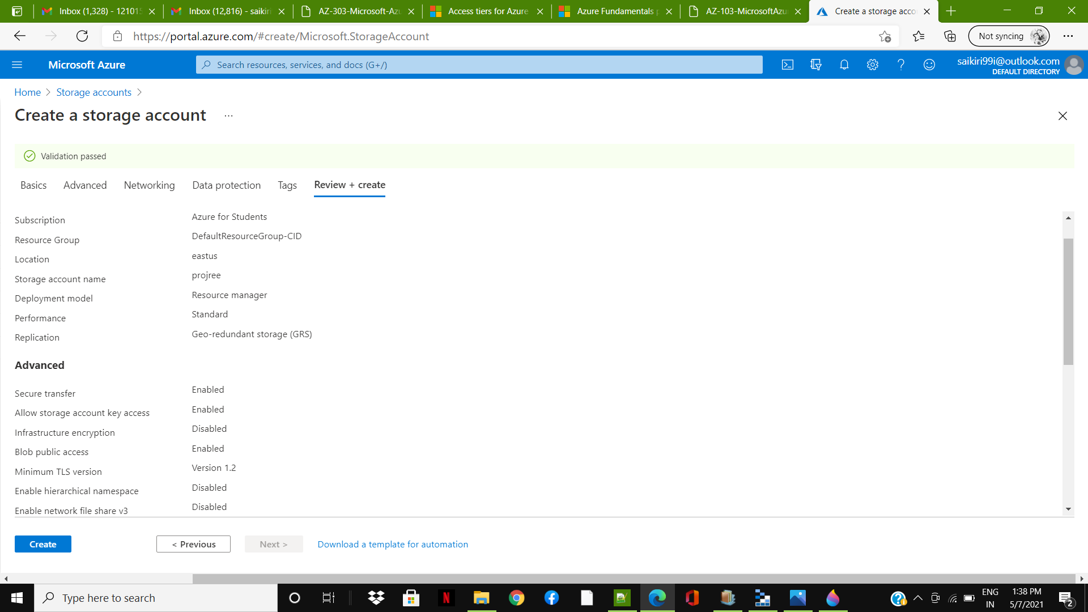
Results

Slide 17
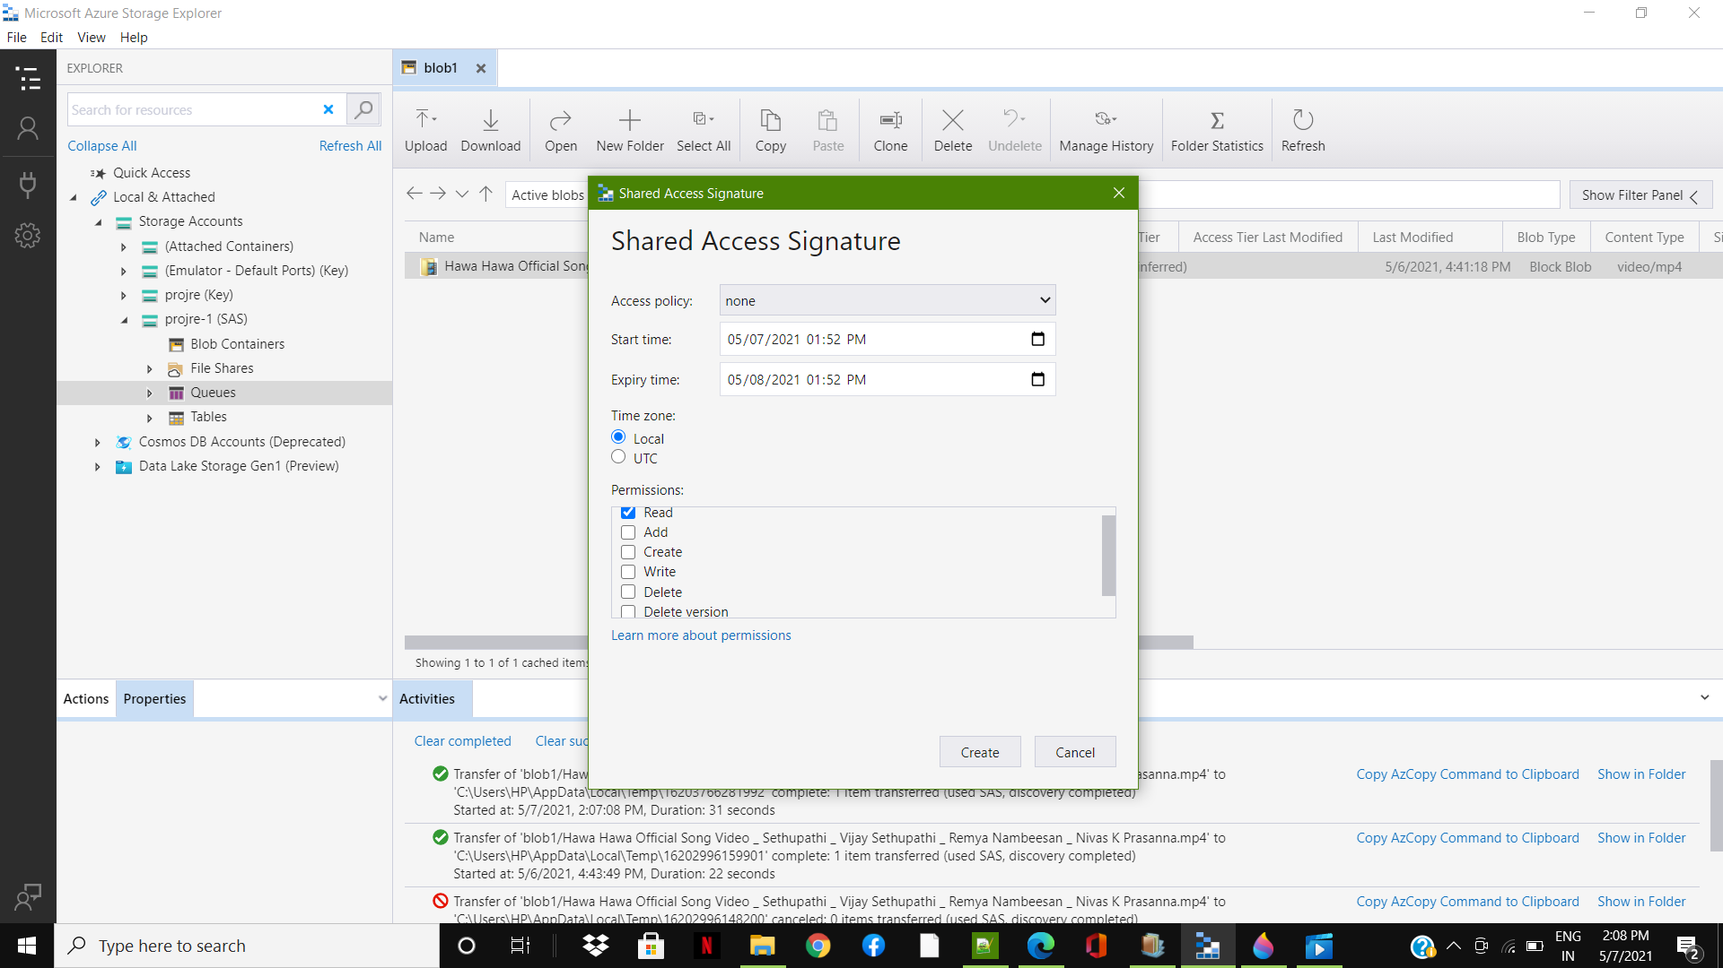
Results

Slide 18
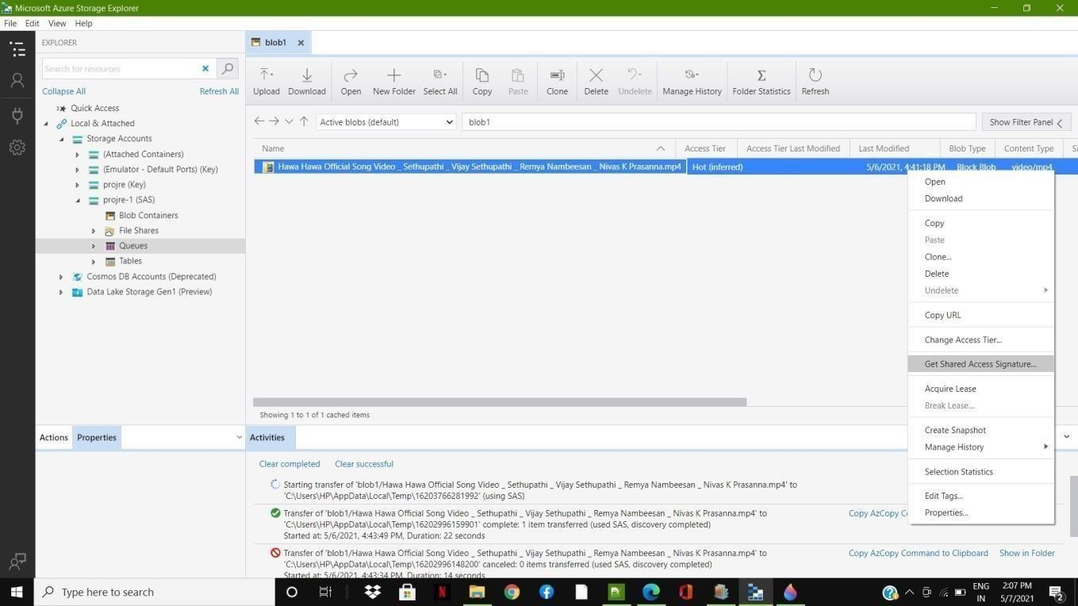
Results
Final output of Saas connected in cloud storage

Slide 19
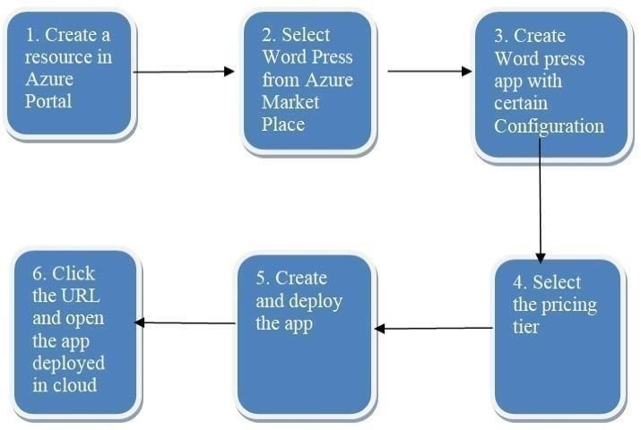
Methodology 2
Wordpress app deployed in Azure:

Slide 20
Methodology 2
1.Create a resource in Azure portal:
Log in to the account by using the person’s account details. On the top left of the Azure portal pane, select Create a resource.
2.Select word press from Azure Market place:
We need to go to Azure marketplace and we need to install Word Press, so we can do quick search for it. In the Marketplace box with the listed application options, search Word Press. Select the default Word Press option from the list of options available.

Slide 21
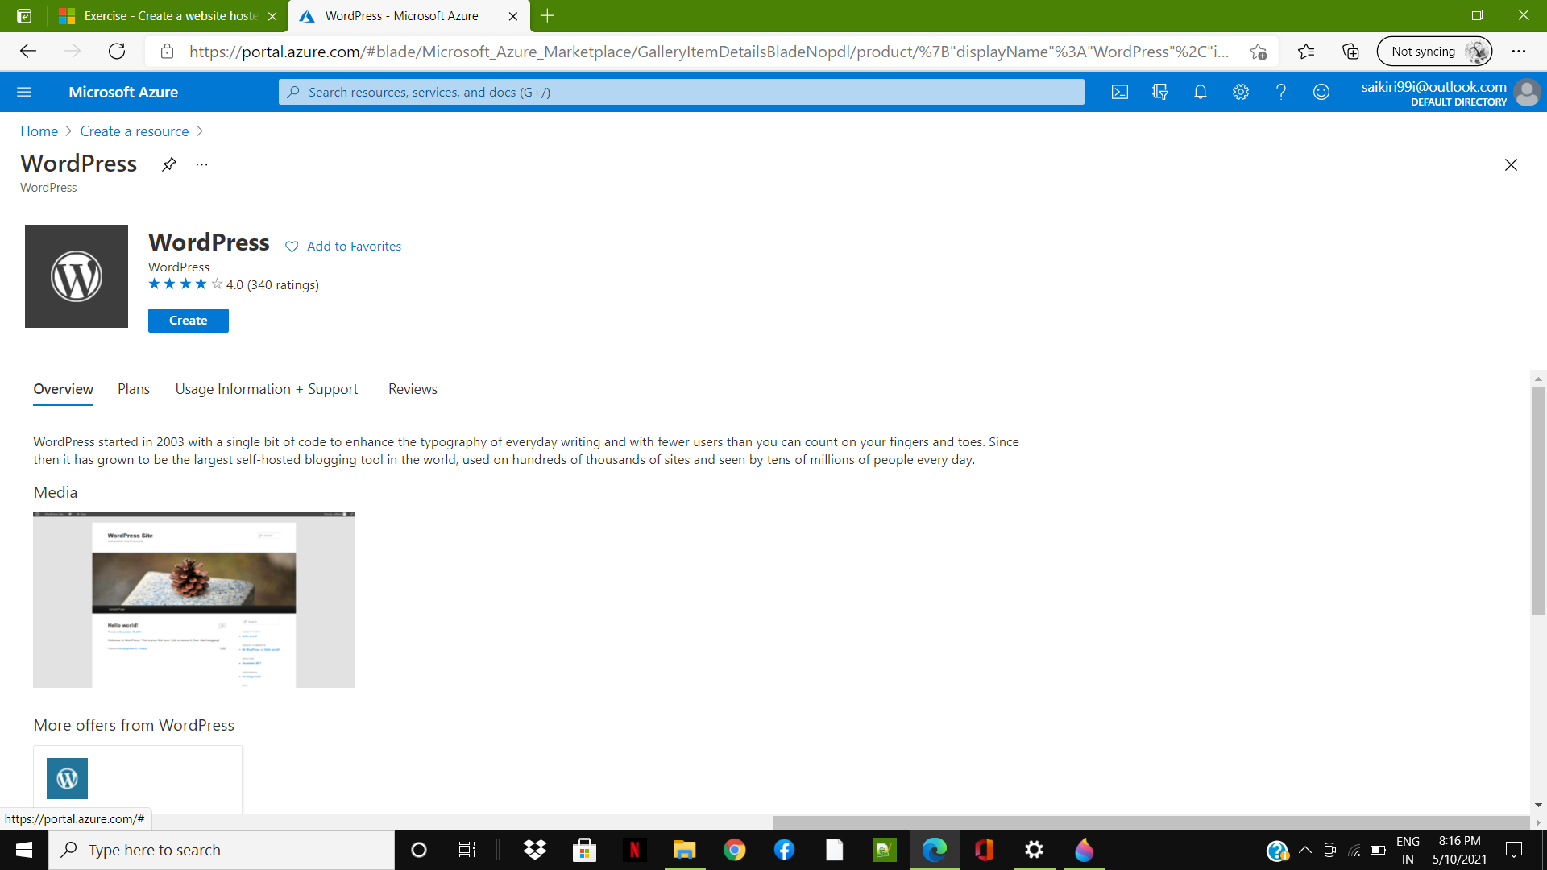
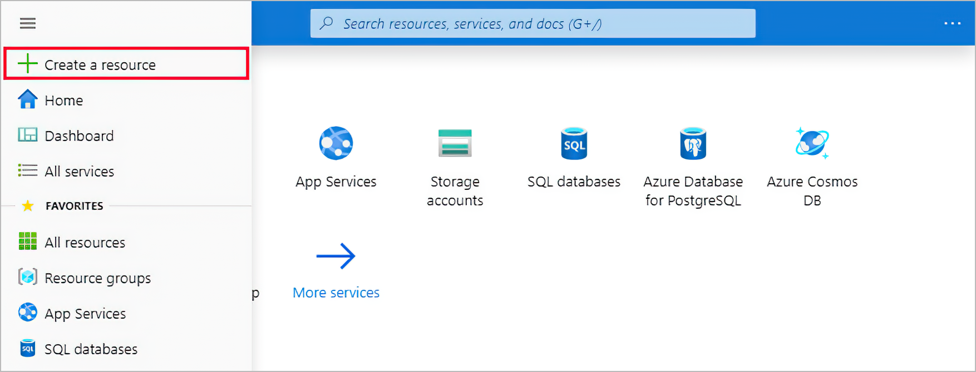
Methodology 2

Slide 22
Methodology 2
3.Create Word press App with certain configuration:
We need to create unique App name and we should select a subscription as Azure for students and we need to select an existing resource group and we need to select the database provider as MySQL in App. We must select the service plan and the location which is comfortable and near to us and we need to leave the rest configuration as default.
4.Select the Pricing tier:
We must select the pricing tier as S1 Standard in the Azure portal.

Slide 23
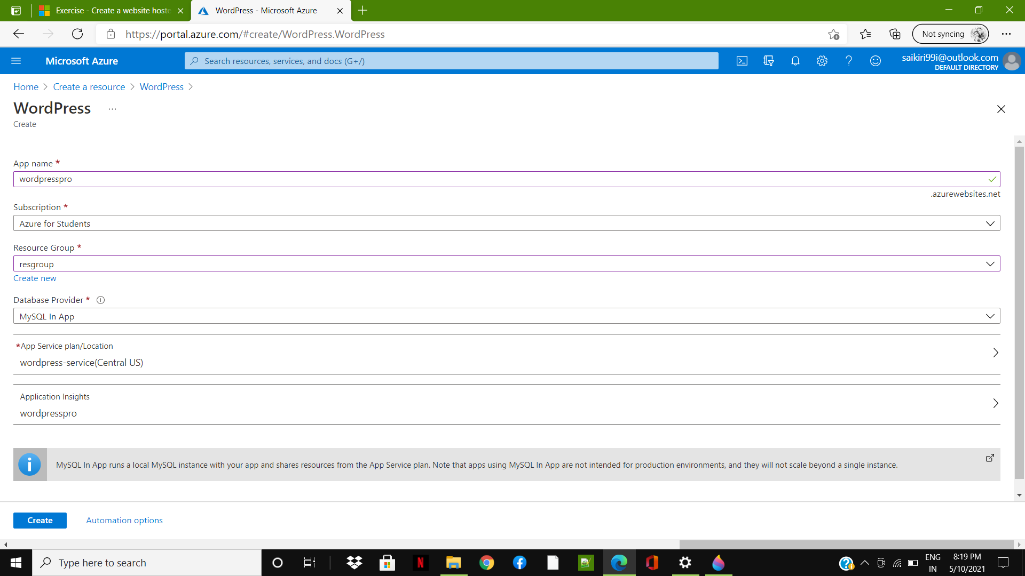
Methodology 2

Slide 24
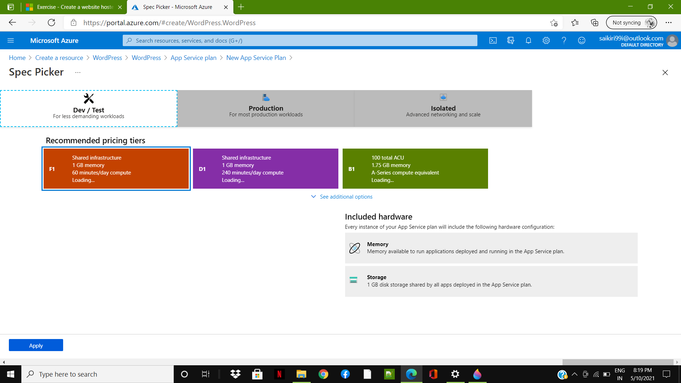
Methodology 2

Slide 25
Methodology 2
5.Create and deploy the App:
After giving these specific configurations we need to check whether the validation is passed and then we must click the option create and Deploy the App. The deployment will take for several minutes to be deployed.
6.Open the App deployed in the cloud:
Now we need to Copy the URL information by selecting the Copy to clipboard icon at the end of URL. Open a new tab in your browser, paste this URL, and press Enter to browse to your new word press site. You can now configure your WordPress site, and add content and the App is successfully deployed in the cloud.

Slide 26
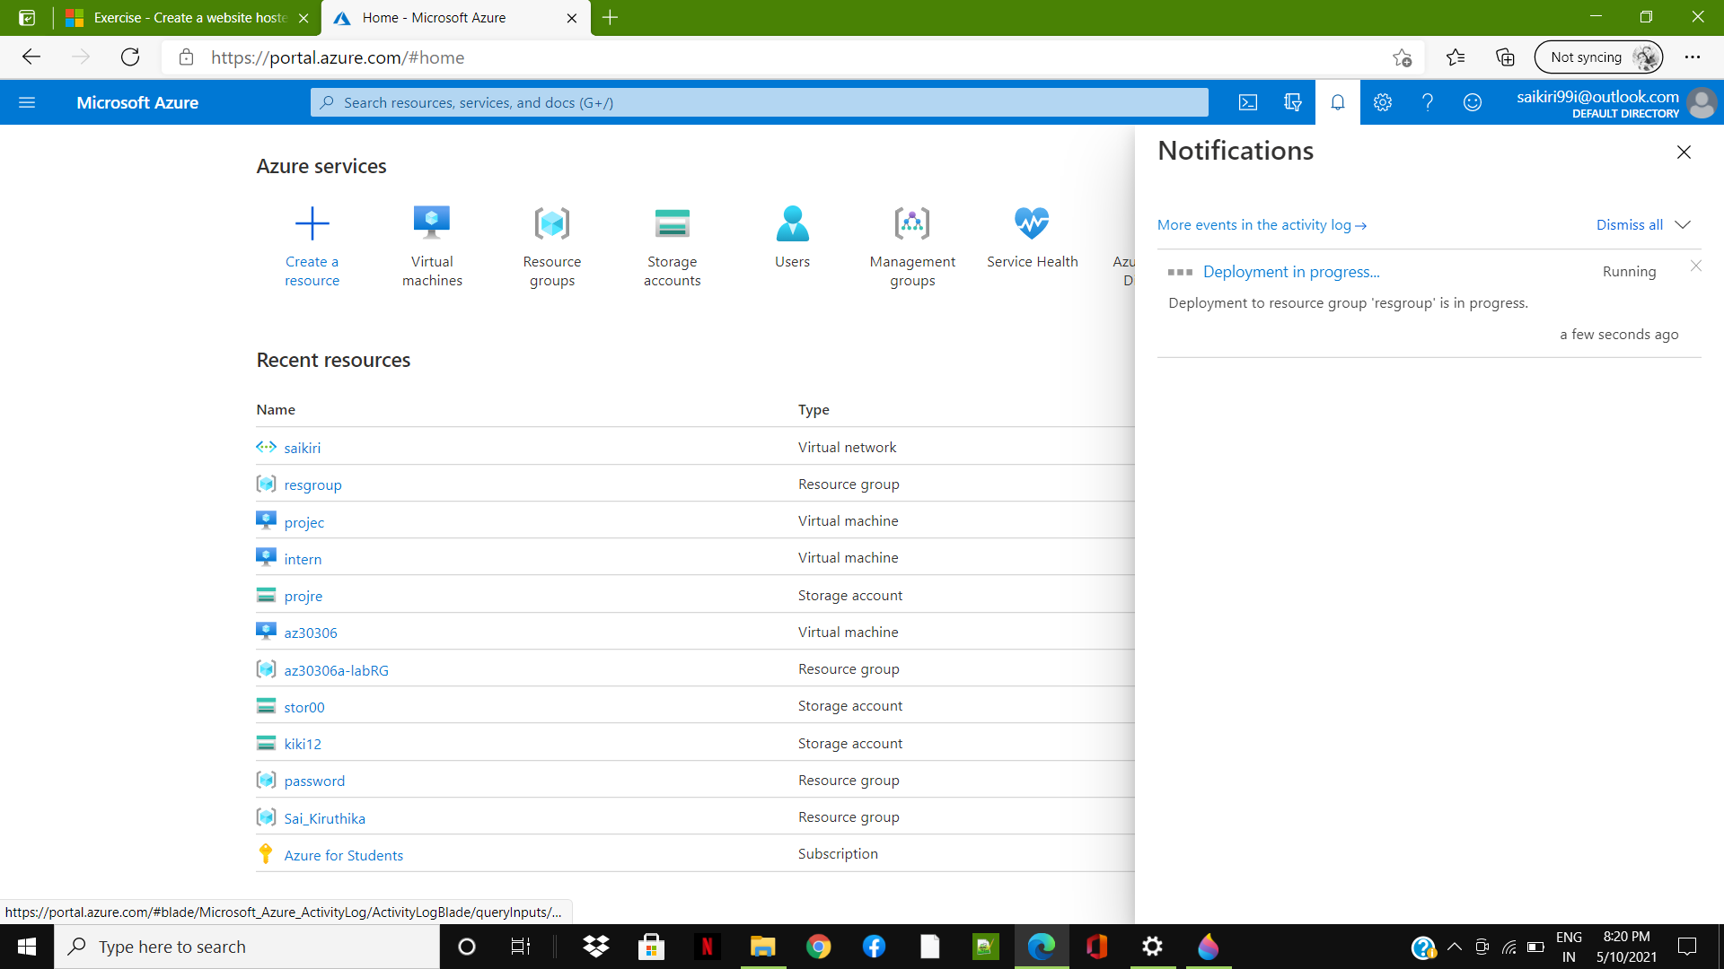
Methdology 2

Slide 27
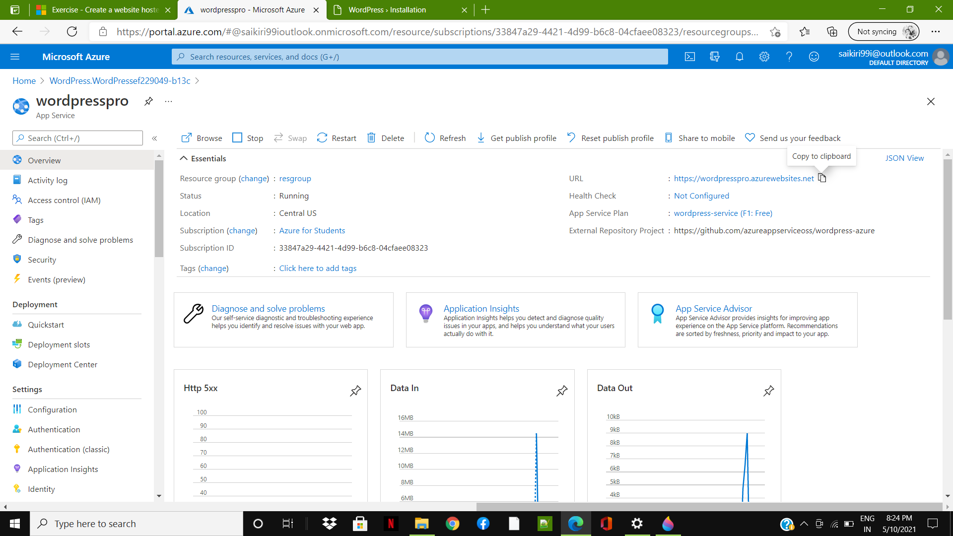
Methdology 2

Slide 28
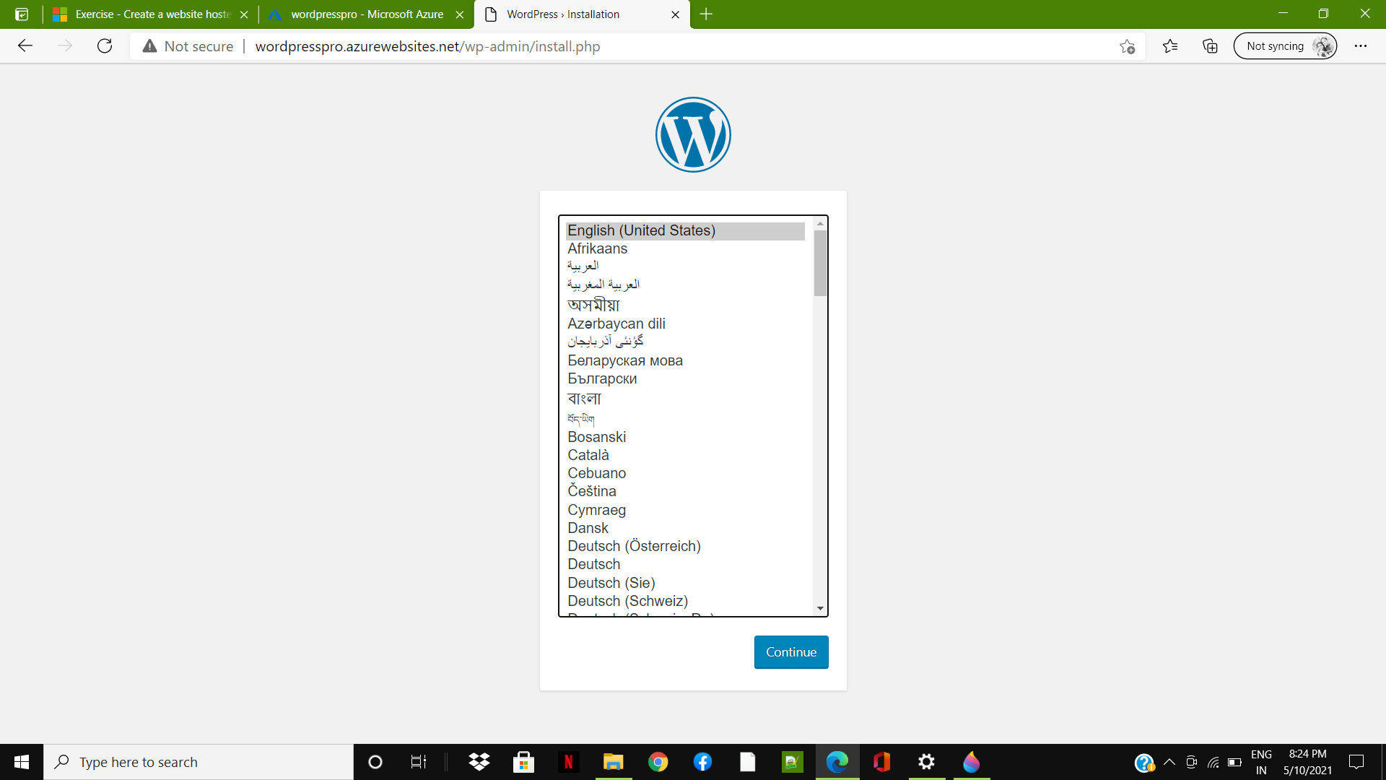
Result

Slide 29
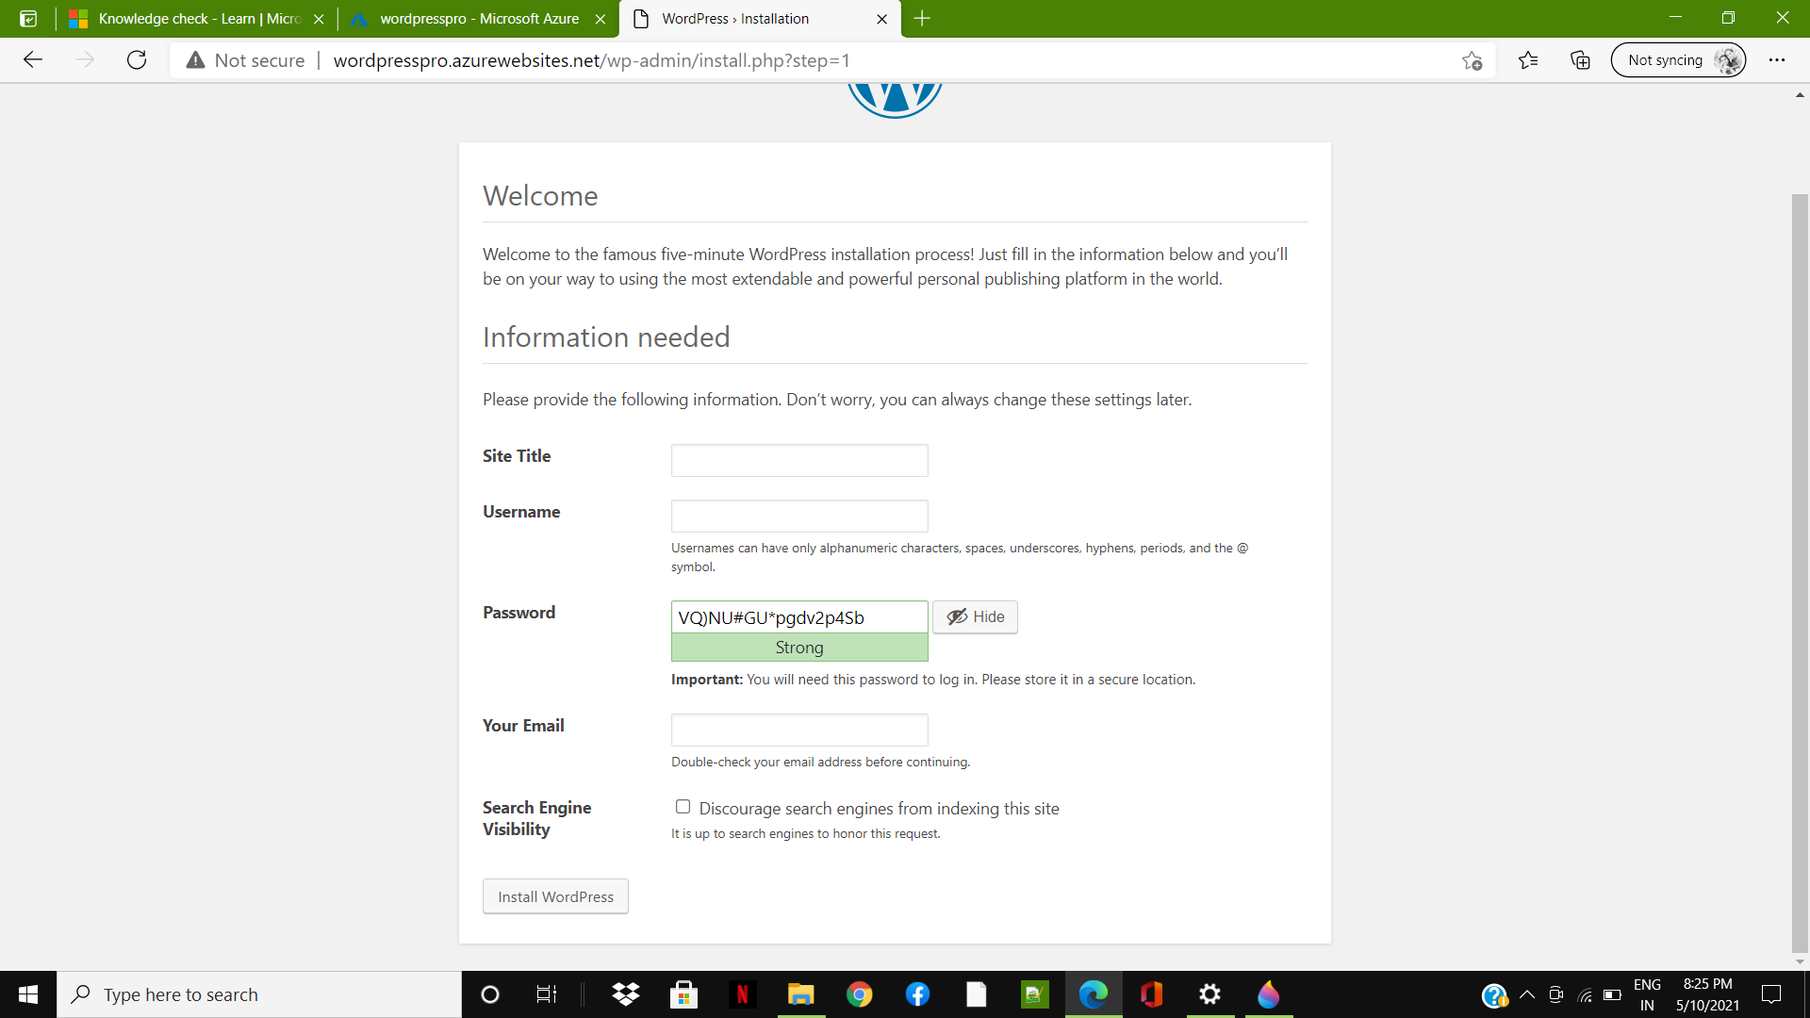
Result

Slide 30
Conclusion
From the implementation of Experiment 1 (Implementing Blob storage by using SAS)
I have accomplished the objectives given by the business and implemented the storage access in both cloud and storage explorer and implemented the following tasks.
From the implementation of Experiment 2 (Deploying a word press App in cloud).
I have accomplished the objectives given by the business and implemented the app in the cloud for the business use by Creating a word press app and deployed using a URL in Microsoft azure cloud

Slide 31
Conclusion
During my internship period these were the important task given to me and even many more learning’s and task were given on equal interval of time and I learnt about cloud and how azure helps my organization in deploying their project.

Slide 32
Reference
1.Azure Learning (2021) Microsoft Learning https://docs.microsoft.com/en-us/learn/modules/azure-architecture-fundamentals/
2. Azure Learning (2021) Microsoft Learning https://azure.microsoft.com/en-in/overview/what-is-cloud-computing/
3.Azure Learning (2021) Microsoft Learning https://en.wikipedia.org/wiki/Cloud_computing
4.Azure Learning (2021) Microsoft Learning https://docs.microsoft.com/en-us/learn/paths/az-900-describe-cloud-concepts/
5.Azure Learning (2021) Microsoft Learning https://docs.microsoft.com/en-us/learn/paths/az-900-describe-core-solutions-management-tools- azure/

Slide 33


